Slide 1
TEST001
Post-Test Data Report

Slide 2
Report Information

Slide 3
Notes
Device Breakdown
Desktop - 27.42% (2,256 Impressions)
Mobile - 34.87% (2,869 Impressions)
Tablet - 37.71% (3,102 Impressions)
Date range
All data in this report is from 20 November 2023 to 05 December 2023
Chart Value Rounding
Values displayed in the charts are rounded to the nearest visible decimal place.

Slide 4
Primary Metrics

Slide 5
Purchases Rate
Primary Metric

Slide 6
Purchases Rate
This metric represents the number of purchase events that occur after an Impression.
This metric is the total number of "purchase" events, which are tracked each time a user completes a transaction.
An increase in Purchase Rate is a positive result.

Slide 7
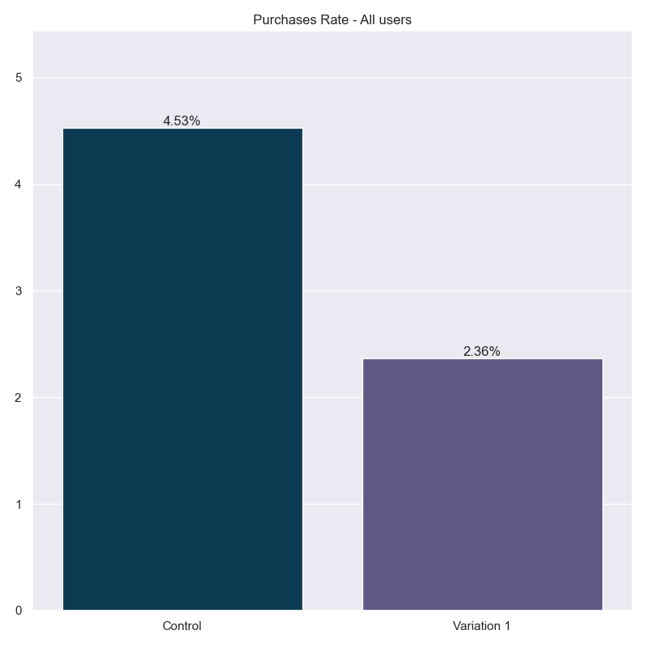
Purchases Rate
Segment: All users
 | Control | Variation 1
Impressions | 3,068 | 5,159
Purchases | 139 | 122
Purchases Rate | 4.53% | 2.36%
Impact | 0.00% | -47.80%
Chance of being best | 50.00% | 0.00%
Segment definition: All users who saw the test at least once.

Slide 8
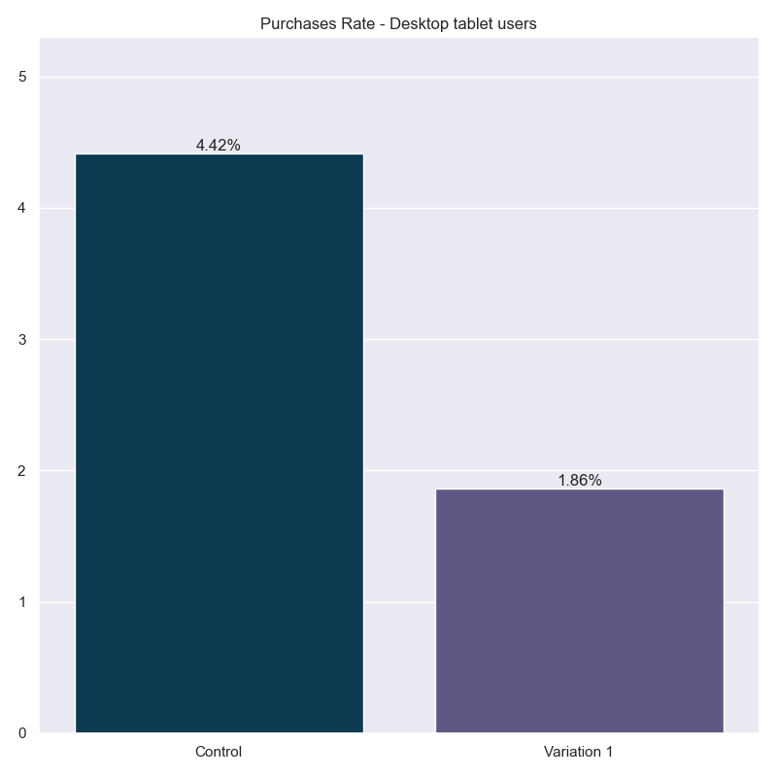
Purchases Rate
Segment: Desktop tablet users
 | Control | Variation 1
Impressions | 1,925 | 3,433
Purchases | 85 | 64
Purchases Rate | 4.42% | 1.86%
Impact | 0.00% | -57.78%
Chance of being best | 50.00% | 0.00%
Segment definition: Desktop and Tablet users who saw the test at least once

Slide 9
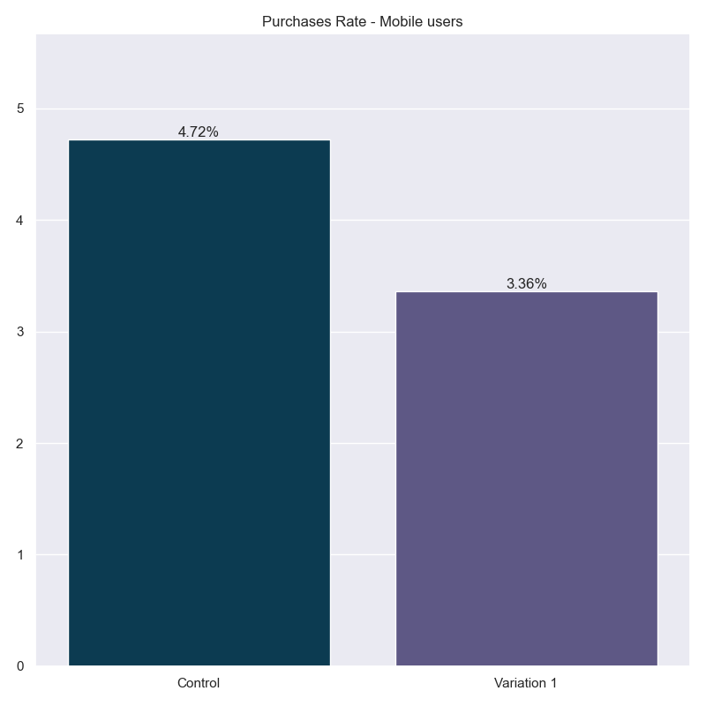
Purchases Rate
Segment: Mobile users
 | Control | Variation 1
Impressions | 1,143 | 1,726
Purchases | 54 | 58
Purchases Rate | 4.72% | 3.36%
Impact | 0.00% | -28.87%
Chance of being best | 50.00% | 3.25%
Segment definition: Mobile users who saw the test at least once

